Slide 1
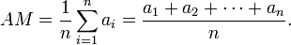
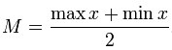
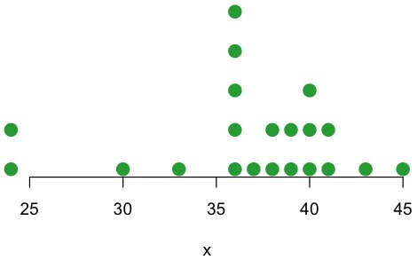
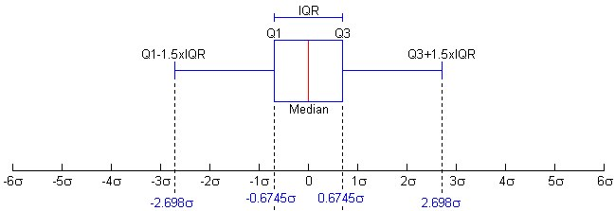
Data Types
MULTI-variate
(multiple variables)
CATEGORICAL (Qualitative) Sex (M/F), Eye Color (Gr, Bl, Br, Hz), State(Al, Az, Ca)
NUMERIC (Quantitative) Discreet (Whole Number, Student Grade on 5Q Test, Times to pass Drv Test)
Continuous (Uncountable Number, SPLdb, Time between 1st&2nd Place)
Uni-variate
(one variable)
Bi-variate
(two variable)
Descriptive Statistics
Central Tendency Measures Relates to the way in which quantitative data is clustered around some value. A measure of central tendency is a way of specifying - central value.
MEAN is often used to report central tendencies, it is not a robust statistic, meaning that it is greatly influenced by outliers. Notably, for skewed distributions, the mean may not accord with one's notion of "middle", and robust statistics such as the median may be a better description of central tendency.
or
Median is described as the numerical value separating the higher half of a sample, a population, or a probability distribution, from the lower half
Mid-Range of a set of statistical data values is the arithmetic mean of the maximum and minimum values in a data set
Variance of a random variable or distribution is the expectation, or mean, of the squared deviation of that variable from its expected value or mean. Thus the variance is a measure of the amount of variation of the values of that variable, taking account of all possible values and their probabilities or weightings (not just the extremes which give the range).
Standard deviation is a widely used measure of variability or diversity used in statistics and probability theory. It shows how much variation or "dispersion" there is from the average (mean, or expected value). A low standard deviation indicates that the data points tend to be very close to the mean, whereas high standard deviation indicates that the data points are spread out over a large range of values.
Interquartile range (IQR), also called the midspread or middle fifty, is a measure of statistical dispersion, being equal to the difference between the upper and lower quartiles.
IQR = Q3 − Q1
Unlike (total) range, the interquartile range is a robust statistic, having a breakdown point of 25%, and is thus often preferred to the total range. The IQR is used to build box plots, simple graphical representations of a probability distribution. For a symmetric distribution (so the median equals the midhinge, the average of the first and third quartiles), half the IQR equals the median absolute deviation (MAD). The median is the corresponding measure of central tendency.
Z-scores indicates how many standard deviations an observation or datum is above or below the mean. It is a dimensionless quantity derived by subtracting the population mean from an individual raw score and then dividing the difference by the population standard deviation. This conversion process is called standardizing or normalizing
(B/B) Stem and Leaf Plot
(Putting Data into Bins and Stacks
38 24 40 36 36 41 38
24 40 41 45 37 36 36
39 40 36 43 33 39 30
4 4 2 44
998876666630 3 036666678899
531100 4 0001135
Strip Chart Instead of stems x-axis. Rather than bins, identical items stacked. Dots than digits
Deviation xi = xi - x
Histogram (Good for Large Data sets)
Density estimate can capture what happens with more data, displaying smooth curve showing the shape of the data distribution
min
max
H₁
H₂

Slide 2
One Categorical Variable results in a..
Two or more result in a….
Frequency Table!
Clear | Partly Cloudy | Cloudy
11 | 11 | 9
Contingency Table!
(Joint Frequencies…)
Marginal Frequencies, (for SEX)
Marginal Frequencies for Computer
And…Relative Frequency Table!
Clear | Partly Cloudy | Cloudy
.36 | .36 | .3
(Divide each count by relative sample, (in this case 3))
Calculating Joint and Marginal Proportions…
1st…
2nd…
Finally..
Finally…
1st…
Conditioning on Computer…
Conditioning on Sex…
1st…
Finally…

